Slide 1
Multi Object Detection Using YOLO v1 Joseph Redmon, Santosh Divvala, Ross Girshick, Ali Farhadi
Mrudula Y
50290843
Shishir Suvarna
50290573

Slide 2
List of topics
Object detection
Applications of Object Detection
YOLO - Problem Statement
YOLO - Motivation
YOLO Algorithm
YOLO - Network architecture
Training the YOLO model
Code Explanation
Results
Limitations
Conclusions
References

Slide 3
Object Detection
Involves detecting instances of objects from a particular class in an image.

Slide 4
Applications of Object Detection

Slide 5
Self-Driving Cars:

Slide 6
Object Tracking:

Slide 7
Optical Character Recognition

Slide 8
YOLO - You Only Look Once

Slide 9
Problem statement
YOLO is a new approach to object detection formulating it as a regression problem to spatially separated bounding boxes and associated class probabilities while having a unified single network architecture such that it reasons globally about the full image and all the objects in the image.

Slide 10
Motivation
Current detection systems repurpose classifiers to perform detection
These complex pipelines are slow and hard to optimize since each individual component must be trained separately
Current systems look at only a part of the image at one time. Hence, the global context of the image is not being captured by these systems
Bottomline: YOLO solves all the above problems by making predictions with a single network faster, which makes it suitable for real time detection

Slide 11
YOLO Algorithm

Slide 12
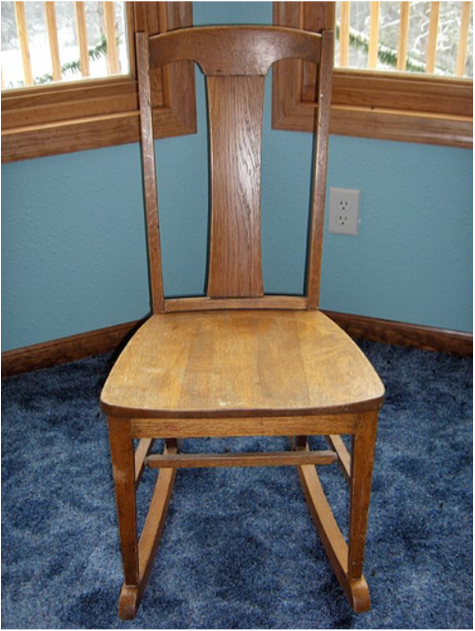
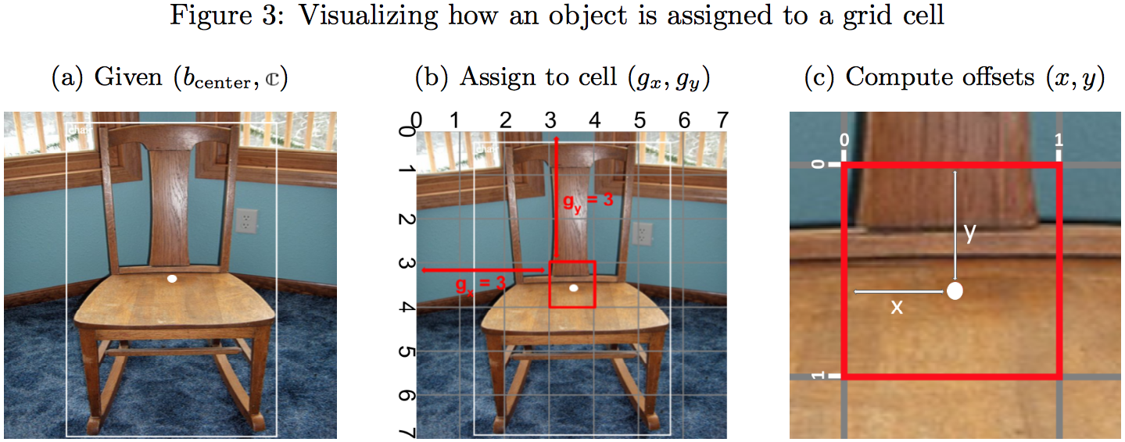
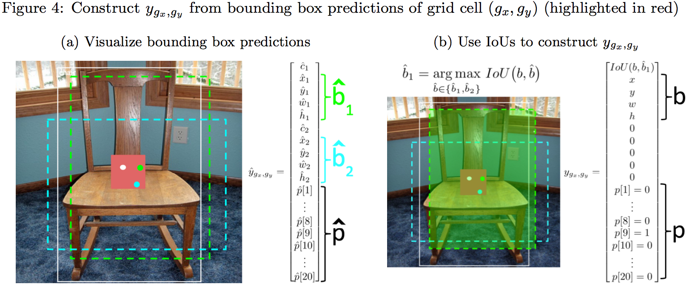
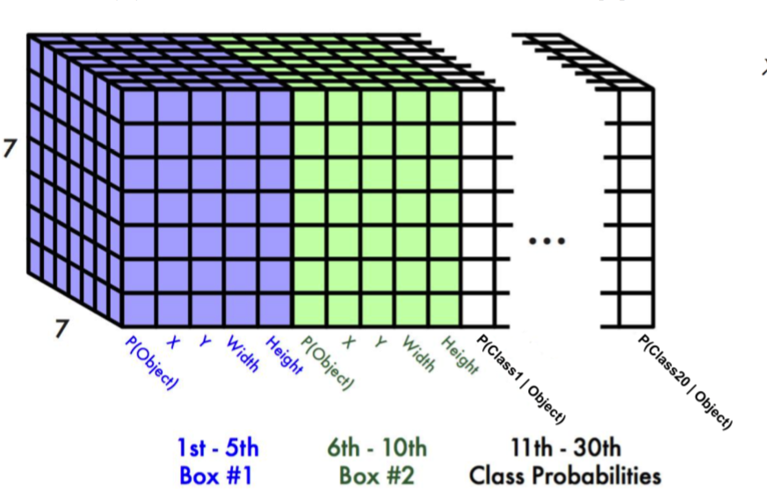
S=7
B = 2

Slide 13
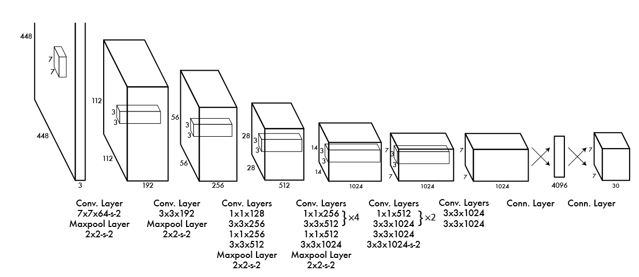
YOLO - Network Architecture

Slide 14
Training the YOLO model

Slide 15
Step 1: Pre-Training
Dataset: ImageNet 2012- 1000 class dataset.
Network: 20-layer convolutional layer network followed by average-pooling layer followed by a fully connected layer.
Accuracy: achieved 88% on the validation set.

Slide 16
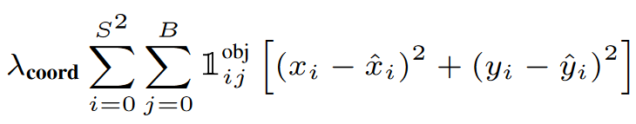
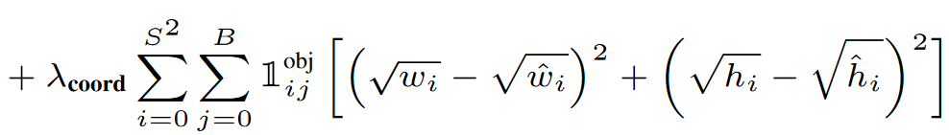
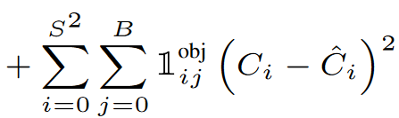
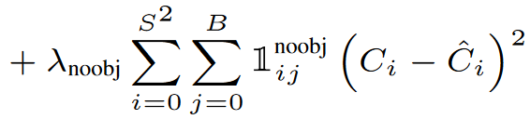
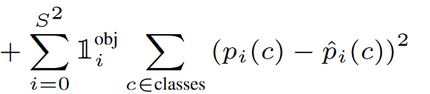
Step 2: Training
Pascal VOC 2012 Dataset
20 classes. The train/val data has 11,530 images containing 27,450 ROI annotated objects and 6,929 segmentations
Hyperparameters/Parameters
135
No. of Epochs
135
Loss Function
Learning Rate
Batch Size
64
Epoch 1-75: 10-2
Epoch 1-75: 10⁻²
Decay
0.0005
Momentum
0.9
Epoch 76-105: 10⁻³
λ_{coord}
5
Epoch 106-135: 10⁻⁴
λ_{noobj}
0.5

Slide 17
Code Explanation

Slide 18
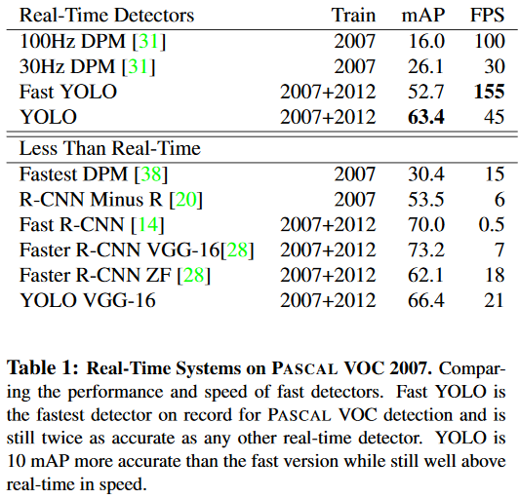
Results

Slide 19
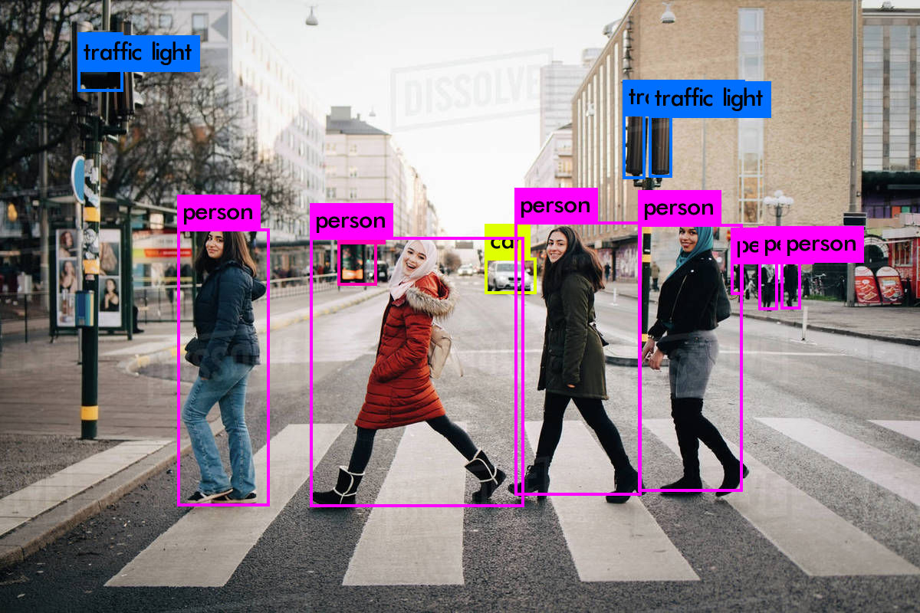
Results

Slide 20
Limitations:
YOLO has spatial limits on how close the objects can be. This affects performance in that YOLO may miss out on certain objects.
YOLO performance
A small error in a large box generally doesn’t affect accuracy a lot but even a small error in a small box has a much greater effect on “intersection over union”. The main source of error is incorrect localizations.

Slide 21
Conclusion
YOLO is an efficient model for object detection which is suitable for many real time applications and newer versions of YOLO improve the accuracy
Notes:
Fast YOLO can process images at 155 frames per second while YOLO V3 can process images at 30 Frames per second with increased accuracy

Slide 22
References:
https://arxiv.org/pdf/1506.02640v5.pdf
https://pjreddie.com/darknet/yolo/
https://towardsdatascience.com/yolo-you-only-look-once-real-time-object-detection-explained-492dc9230006
https://medium.com/@jonathan_hui/real-time-object-detection-with-yolo-yolov2-28b1b93e2088
https://medium.com/oracledevs/final-layers-and-loss-functions-of-single-stage-detectors-part-1-4abbfa9aa71c
https://towardsdatascience.com/yolo-object-detection-in-matlab-start-to-finish-3f78ec80419d
http://host.robots.ox.ac.uk/pascal/VOC/voc2012/VOCtrainval_11-May-2012.tar

Slide 23
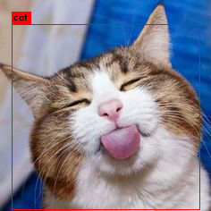
Thanks!

